Slide 1
ERASMUS+ Capacity-building in Higher Education
2017 Selection – main results and tendencies
Erasmus+

Slide 2
Summary of Results
Received applications: 833 (compared to 736 in 2017, +13% increase)
Recommended for funding: 149 (17,6% from 833 submitted proposals)
Joint Projects: 134 (84%)
Structural Projects: 15 (16%)
National: 73 (49%)
Multi-country: 76 (51%) of which 58 regional + 18 cross-regional
Projects with a Partner Country coordinator: 34 (23%)
Countries represented in the selected projects: 103 (out of 147) Partner Countries and 32 (out of 33) Programme Countries
Average consortium size: 12 partners (min. 6 , max. 32)
Average budget: 879.850 €
Erasmus+
Notes:
CBHE Selection 2017
138,68 M € available for 10 regions
833 applications received (13% increase vs. 2016)
Of the 180 countries eligible in 2016, 135 are present (32 of the 33 Programme Countries, and 103 of the 147 eligible Partner Countries), and all regions are covered.
EU-28, Norway, Iceland, Turkey, Liechtenstein, FYROM
The ratio of projects led by Programme Countries compared to Partner Countries is 77% / 23%.
A good balance is noted between national projects (targeting a single Partner Country) vs Multi-country (targeting more Partner Countries from the same region or more regions), 73 national projects (49%) and 76 multi-country projects (51%) including 18 cross-regional projects (12%).

Slide 3
Coverage of submitted applications by regions 2017 vs 2016
Erasmus+
Notes:
Increased interest in the CBHE has been noted in all the 10 Regions compared to 2015.
Part of the increase in applications is related to the fact that the ACP region was opened for the first time and resulted in 53 applications.
Considerable increases can also be noted for the Western Balkans, the Eastern Partnership and Asia (respective increases of 64%, 39% and 105%).
While the budgets are small, there were also gratifying increases in applications for Iran, Iraq, Yemen (8 applications instead of 2 in 2015) and South Africa (14 applications instead of 5).
A slight increase can also be noted in applications led by Partner Countries, with 219 projects or 30% of the total, compared to 26% in 2015.

Slide 4
Selection progress 2017 vs 2016

Slide 5
Selection Results – Type of projects
Notes:
The number of selected proposals for JP Curriculum development (66; 44%) remains very similar with the previous years (43% in 2016 and 45% in 2015).

Slide 6
Selection Results – Priority areas covered
Notes:
The most popular subject areas addressed are
Engineering (16), as under the previous two Calls, but also
Agriculture (10),
Environmental sciences (8),
Physical sciences (7) and
Health (5).

Slide 7
Counsellors
DEMO.IL
Notes:
Social and behavioural sciences
(migrants, disadvantaged people)

Slide 8
PACES

Slide 9
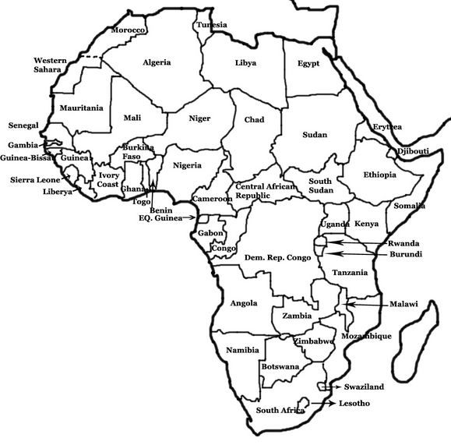
Innovation
AHEAD
Education
Research

Slide 10
SMART
RESEARCHERS
STUDENTS
MOBILE
APPLICATIONS
ENERGY
ENTREPRENEURS
media and creative industries
SMEs
ICT
GIS
ENVIRONMENT

Slide 11
E+ Capacity Building in Higher Education Selection 2017
Stage | 1 Western Balkans | 2 Eastern Partn | 3 South Med | 4 Russian Federa-tion | 6 Asia | 7 Central Asia | 8 Latin America | 9 Iran, Iraq, Yemen | 10 South Africa | 11 ACP | Total*
Reception | 135 | 243 | 196 | 108 | 120 | 121 | 98 | 12 | 12 | 50 | 833
Eligible >60 points | 102 | 167 | 151 | 68 | 76 | 84 | 80 | 6 | 8 | 36 | 609
Sent to Consultation | 36 | 58 | 74 | 34 | 76 | 37 | 30 | 5 | 8 | 23 | 295
Proposed for funding | 16 | 18 | 37 | 11 | 47 | 14 | 15 | 4 | 4 | 7 | 149
(compared to 2016) | (18) | (24) | (36) | (16) | (53) | (19) | (14) | (4) | (5) | (9) | (147)
Success rate 2017 - % | 11,8 | 7,4 | 18,8 | 10 | 39 | 11,5 | 15,3 | 33 | 33 | 14 | 17,6
Grant Agreement
Consultation
Evaluation Committee
Award Decision
Notification & Publication of results
20/05 – 20/06
14/07
24/07-27/07
4/08 – 7/08
15/10 – 31/12
* Figures cannot be added as cross-regional applications are counted in one or two regions
Erasmus+

Slide 12
Lessons learned
Done well:
Take off of "new regions" (LA, Asia, ACP)
National vs Regional vs Cross-Regional
Increased quality of applications
Could have done better:
Larger coverage of priorities, thematic areas
More awareness on cross-cutting priorities
Integration in HE of migrants & refugees from affected countries
Wider diversity of partner / applicant organisations
Projects' innovation potential
Better involvement of students
More active and transparent role of Ministries of Education (strengthening impact at national level)
Erasmus+
Notes:
Of the 180 countries eligible in 2016, 135 are present (32 of the 33 Programme Countries, and 103 of the 147 eligible Partner Countries), and all regions are covered.
EU-28, Norway, Iceland, Turkey, Liechtenstein, FYROM
National vs Regional vs Cross-Regional: equal shares
Increased quality of applications – (less for cross-regional proposals, though)
Main Subject Areas: Applied sciences (engineering) and Environmental sciences Governance, Quality Assurance, Employability
Projects' innovation potential: lots of resubmissions and limited 'novelties'
Better involvement of students – after dropping the SMS
More active and transparent role of Ministries of Education (i.e., for strengthening impact at national level - promotion of SP)

